Slide 1

Commence Your Learning Journey
Certificate IV IT
Matthew Roderick

Slide 2
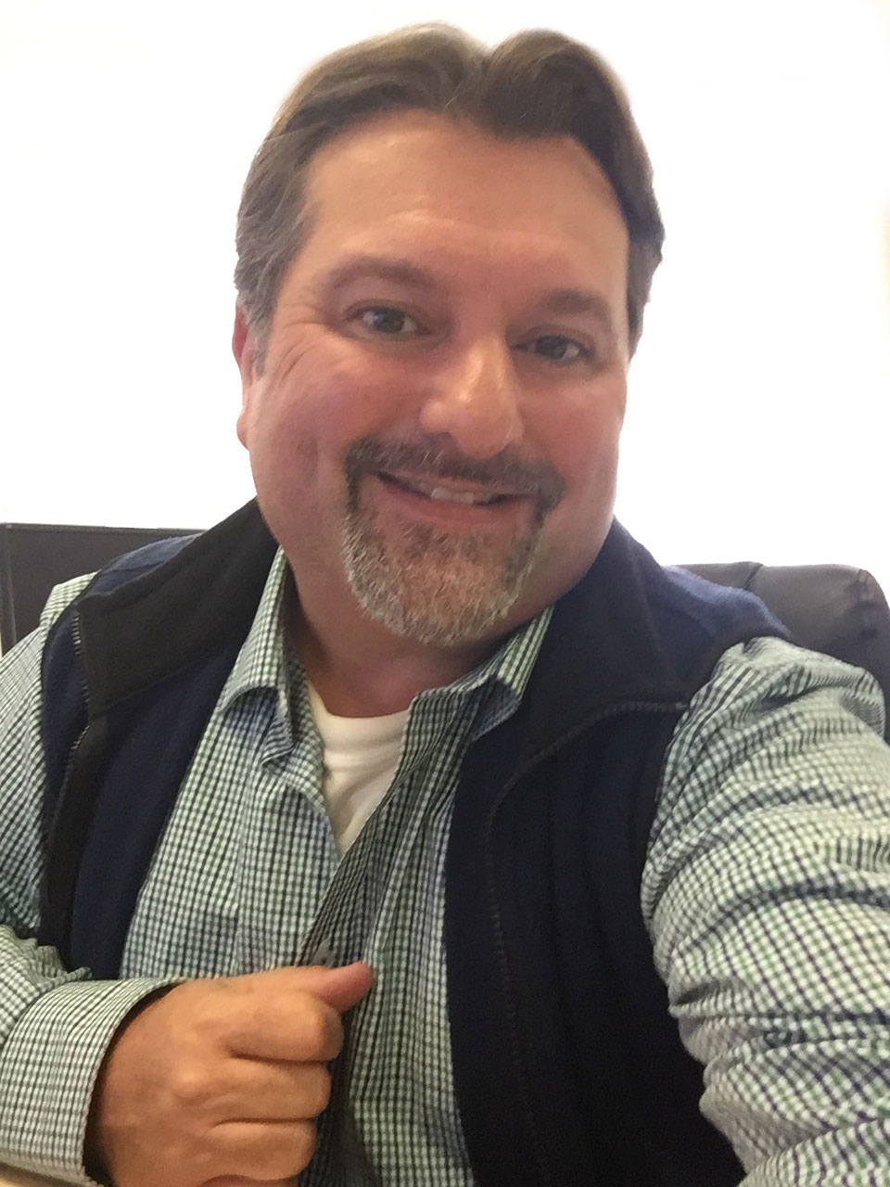
Hosted by Matthew Roderick
Program Coordinator introduction
Working in industry for over 20 years.
Specialties include:
Web development, ecommerce, branding and graphic design, photography and imaging for advertising including event promotion and commercial publication, cloud integration, network design, backup, recovery and system builds.
Training in industry for over 20 years.
Experience includes:
Instructional design, training and assessment for higher education degrees in web development and digital media. Formal qualifications in adult training, business marketing, photography, visual and information technology.
How I can help with your course
Messaging me in Canvas
or Email matthew.roderick@upskilled.edu.au
Booking Support Sessions in Calendar
(Certificate IV Course Home Page)
Ask me questions

Slide 3

Welcome to your Upskilled IT Course
Make sure you’ve logged into Upskilled Canvas to follow along…
Access your Upskilled Canvas account at:
https://upskilled.instructure.com/

Slide 4
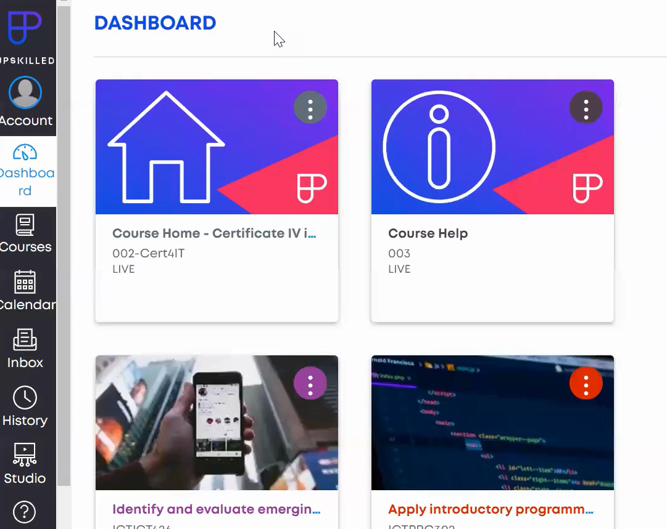
Course Dashboard
- Release of 10 units of competency

Slide 5
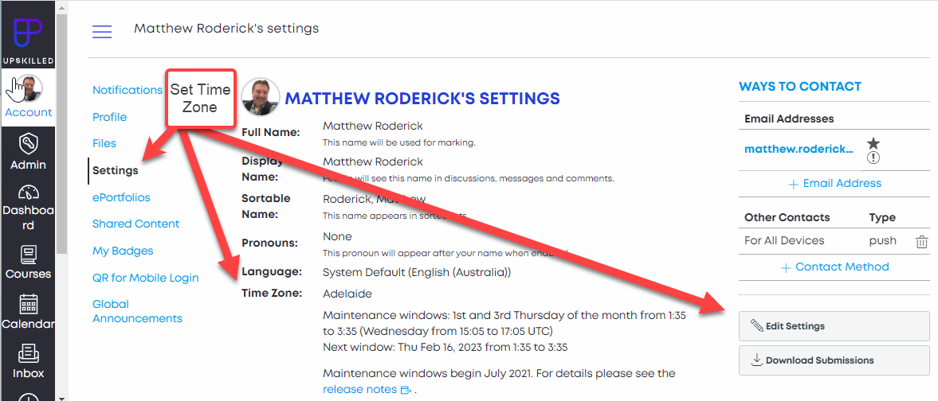
User Profile
Go to Settings > Editing Settings > Time Zone

Slide 6
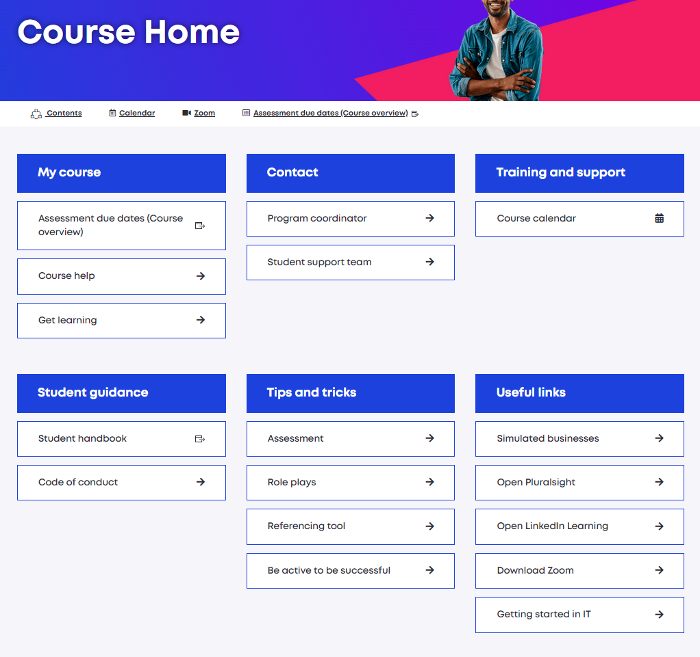
Course Home Page
- Course Overview
- Course Help
- Contact PC and Student Support
- Join Course Calendar Sessions
- Study Tips and Tricks
- Useful Links
- Simulated Businesses

Slide 7
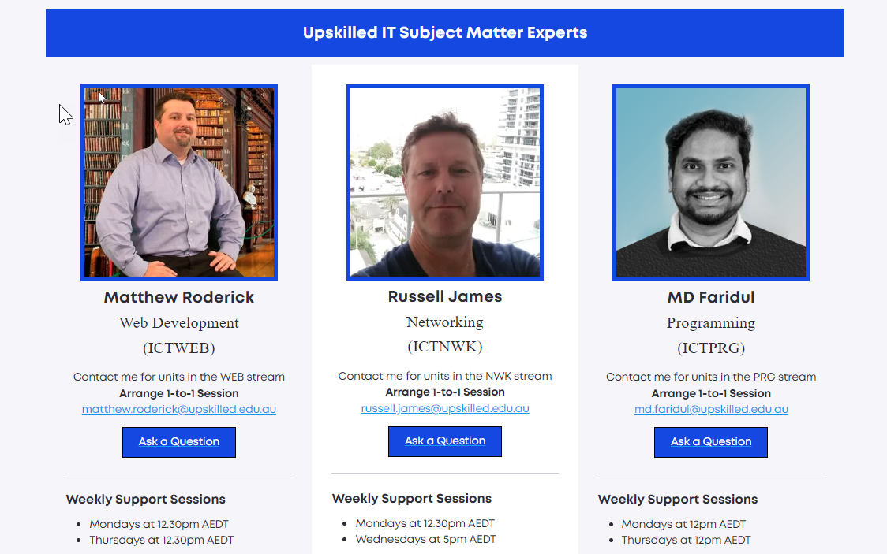
Subject Matter Experts
Matthew Roderick
Web Development
ICTWEB
Russell James
Networking
ICTNWK
MD Faridul
Programming
ICTPRG

Slide 8

Types of Sessions and how to book:
Course Calendar – Training and Support Sessions
Open Your Course Calendar to view available support times.
Training Sessions including Unit specific Training
Assessment Walkthroughs
One-on-One Support Sessions
AMA/Assessment Support Sessions
Drop In Sessions
Role Play Assessment and Practice Sessions

Slide 9
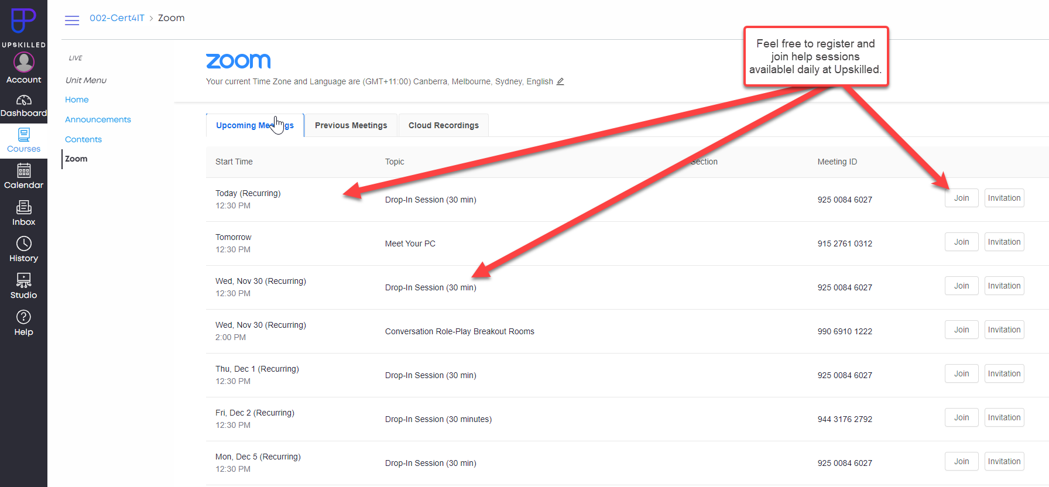
Register for upcoming support sessions using Student Calendar or Zoom module from the Certificate IV IT Homepage.

Slide 10
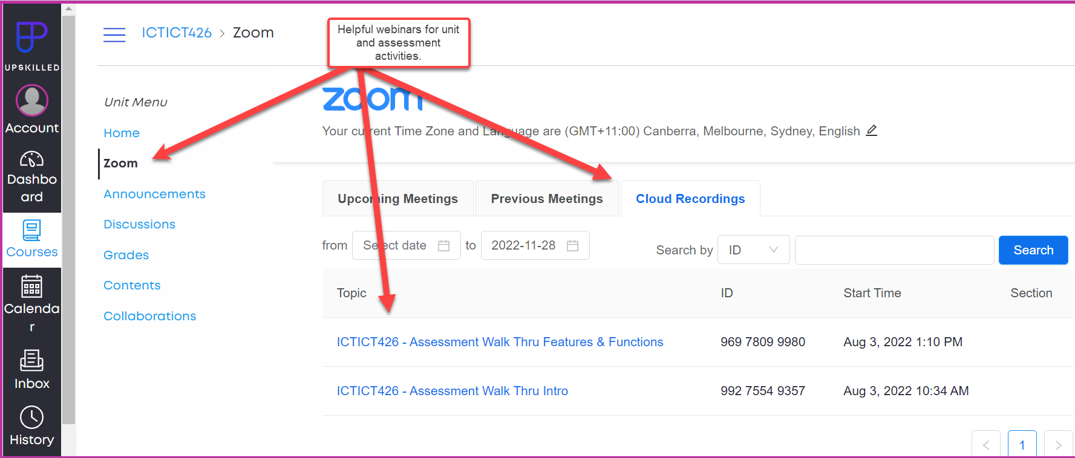
Previously recorded webinars are located under Zoom Cloud Recordings.

Slide 11
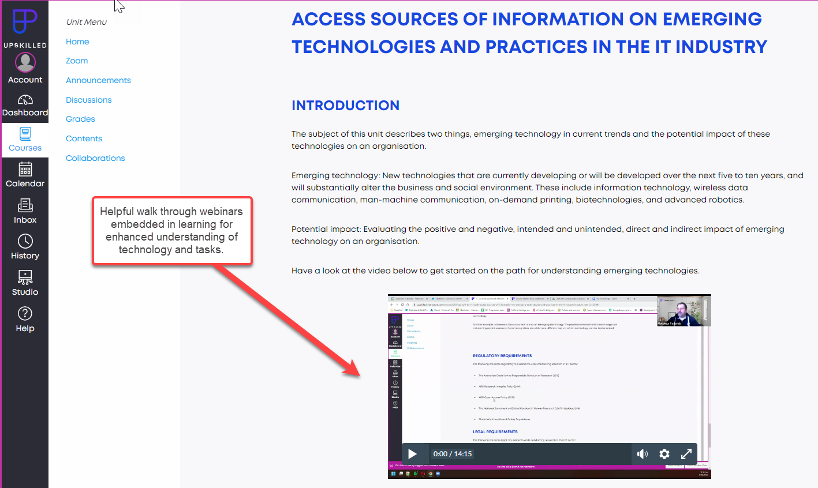
Helpful walkthrough webinars embedded in learning for technology.

Slide 12
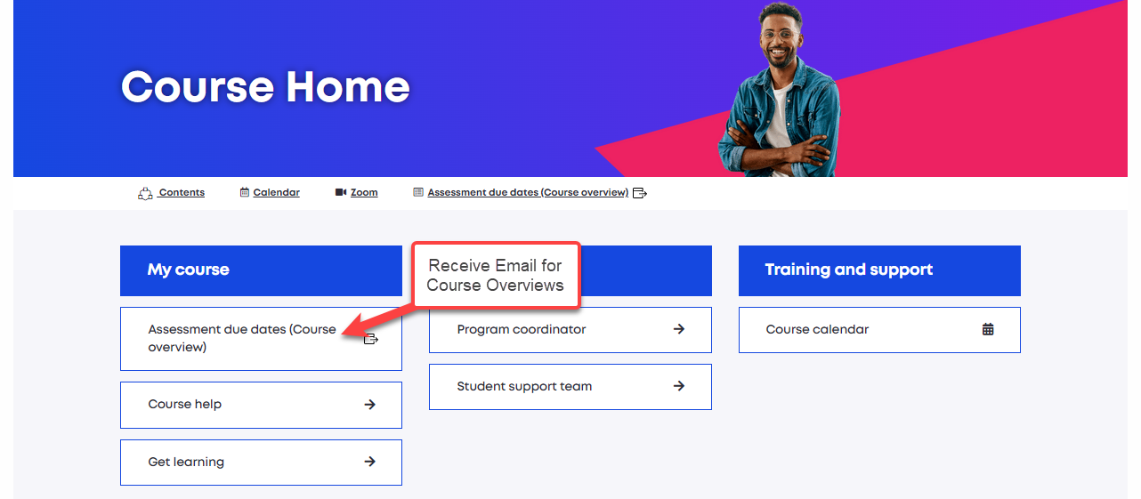
Course Overview Tool
Located on the Course Homepage
-View Procession of Units
-View Assessment Due Dates

Slide 13
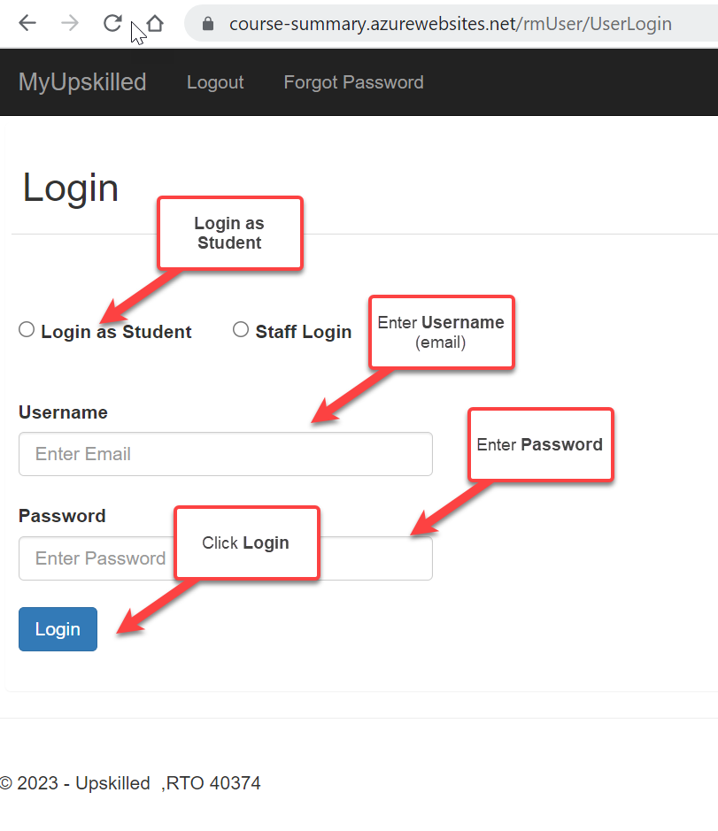
Get Strategic with the Course Overview Tool
https://course-summary.azurewebsites.net/
Upskilled has created a beneficial strategic tool to be used as a “Live” representation of upcoming due dates and completed assessments*.
*Upon signup with Upskilled, you will receive an automated email with login details.

Slide 14
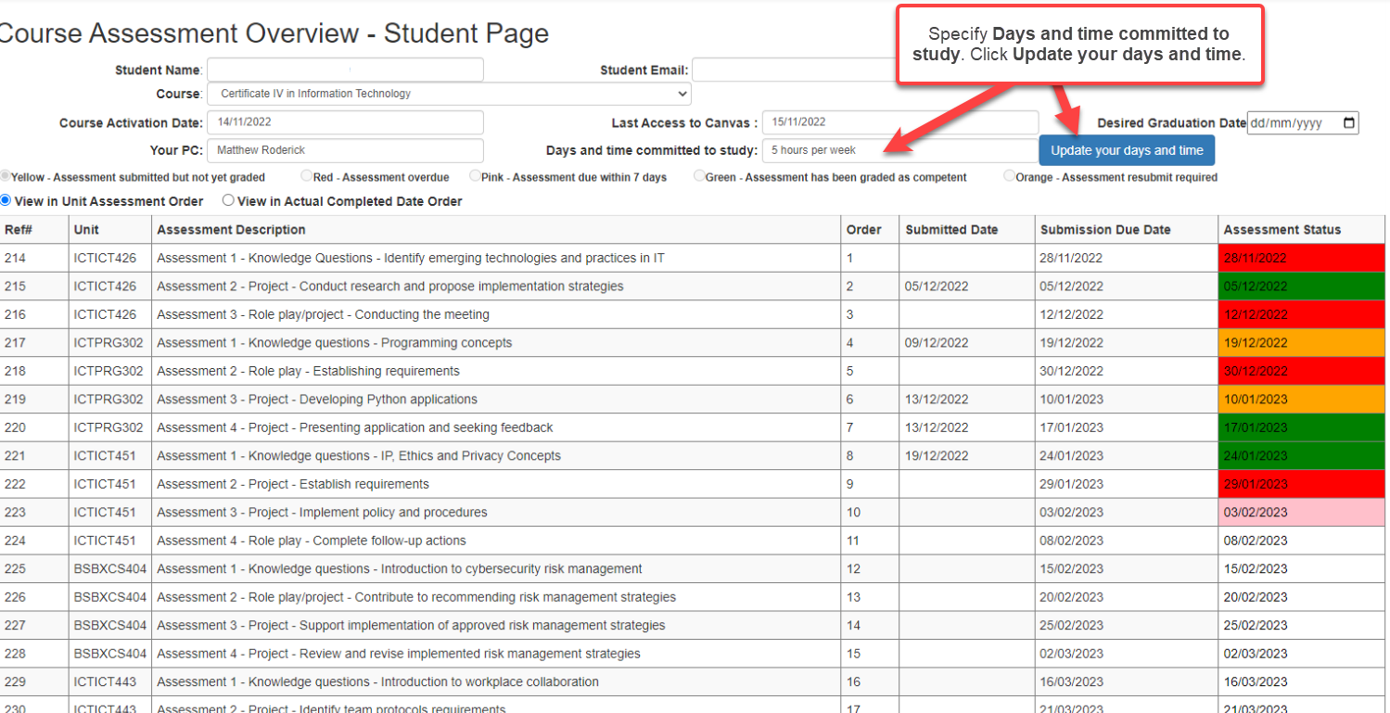
Complete Course Overview Assessment Tool:
Enter Days and time committed to study for your course.
Click Update your days and time.
Review Assessment Due Dates.
Consider booking Support Sessions in the Course Calendar to stay on track.
Your Course Overview and Assessment Due Dates

Slide 15
Review the first Unit of your course
Go to Dashboard in Upskilled Canvas
Open your first Unit
Open ‘Learning’ and go to ‘Welcome’ section and click on ‘Let’s do it’
Complete ‘Discussion’ section in first section of learning.
Now complete ‘Resources Declaration’ section.
After this have a look through your ‘Learning’ and the first ‘Assessment’.
Make sure you feel confident with how your Units work.
Opening additional units as desired.
Review the first Unit of your course and complete the first activity

Slide 16
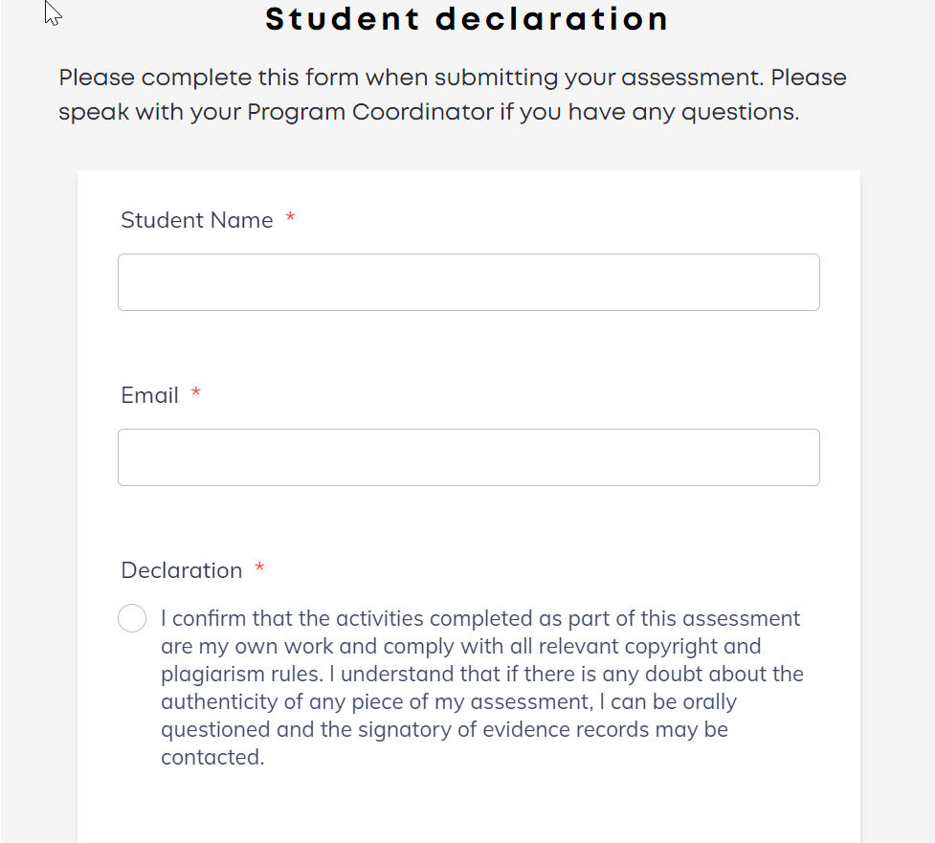
Student Declaration

Slide 17
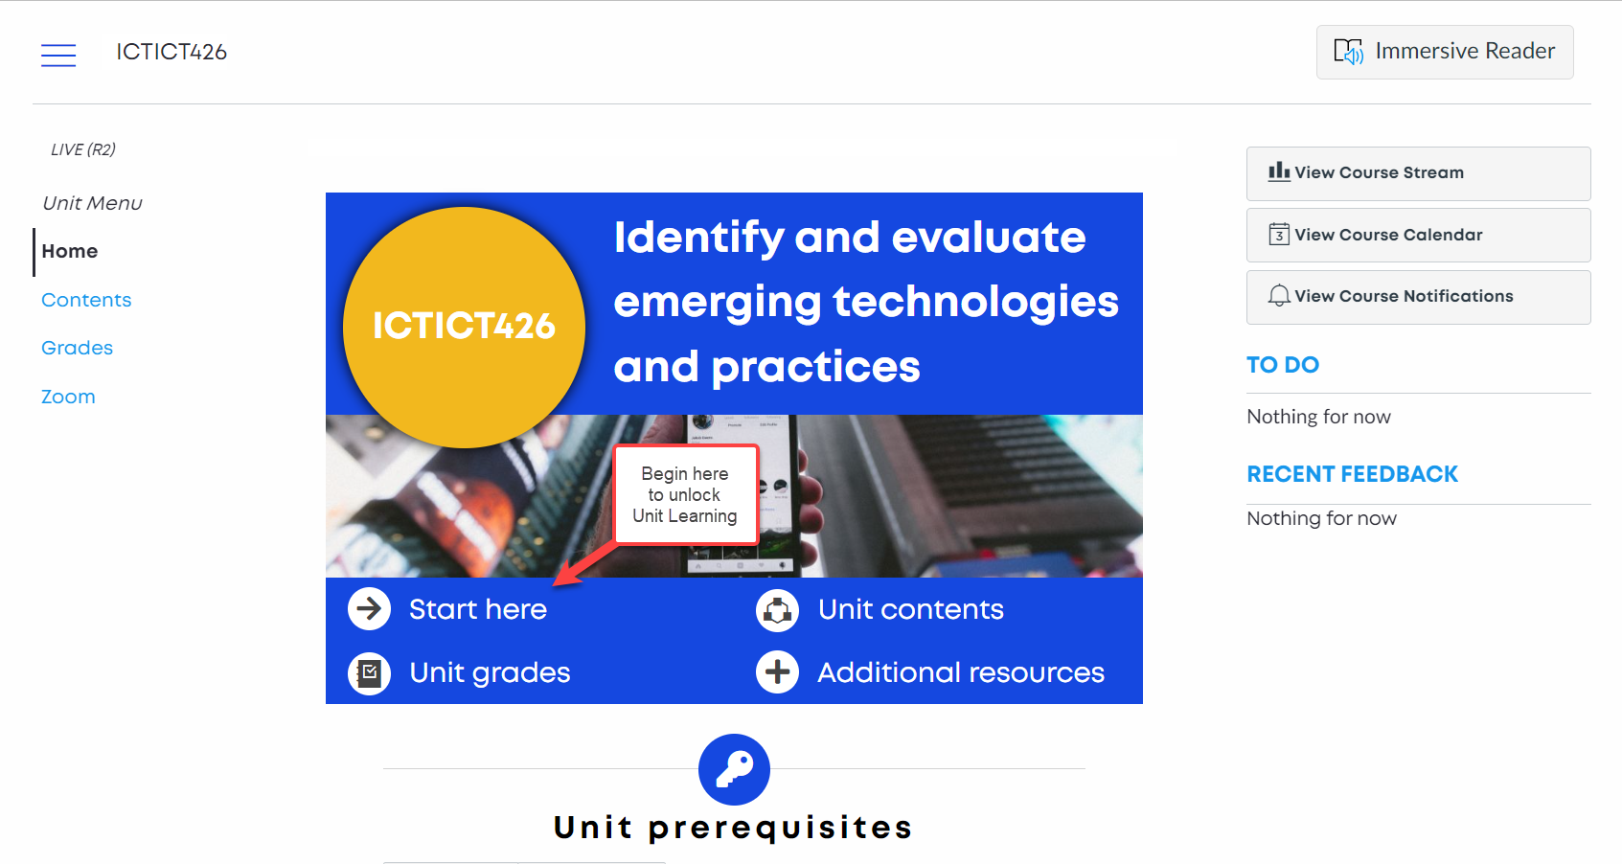
Start here
ICTICT426
Identify and evaluate emerging technologies and practices

Slide 18
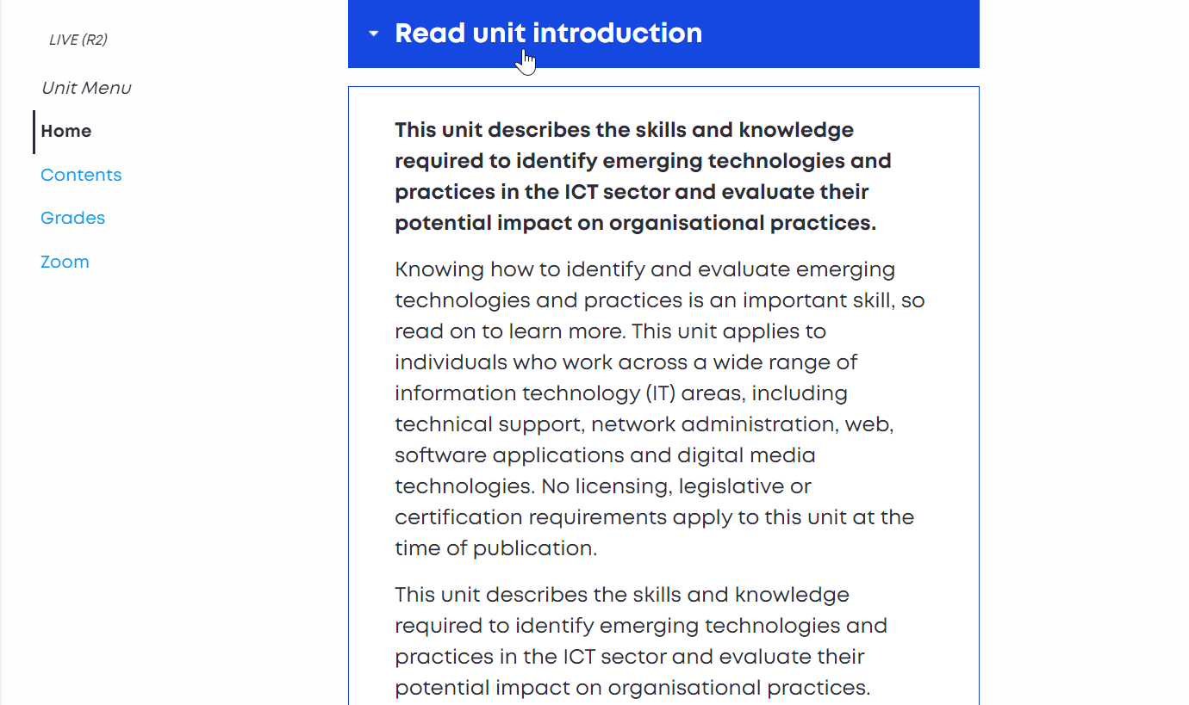
Read unit introduction

Slide 19
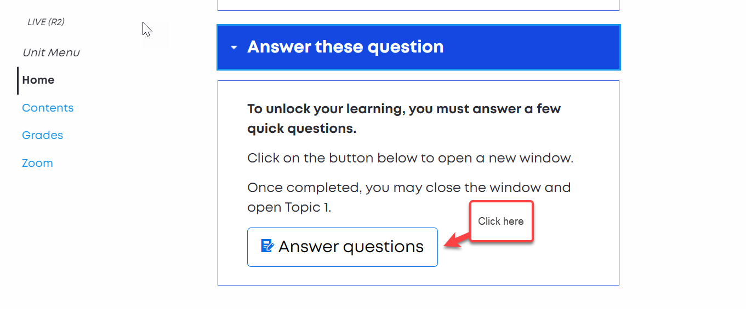
Answer questions

Slide 20
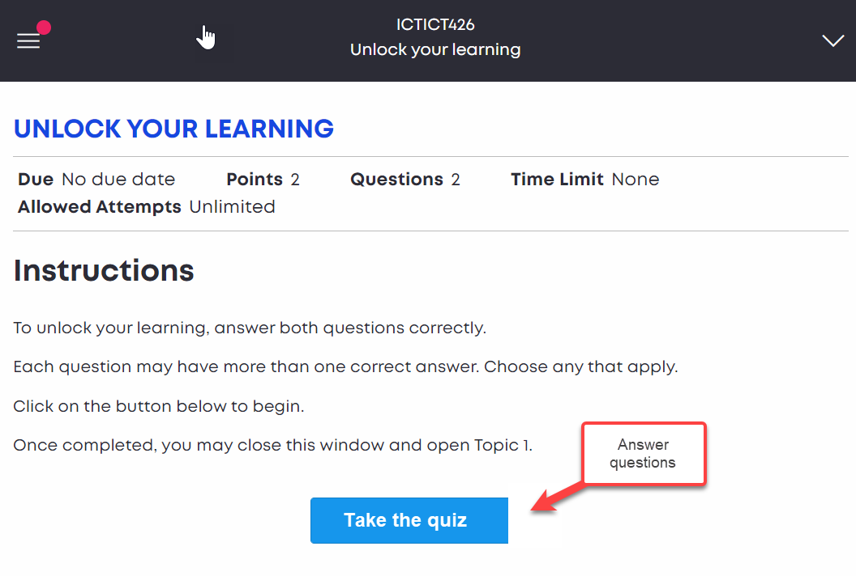
Take the quick quiz

Slide 21
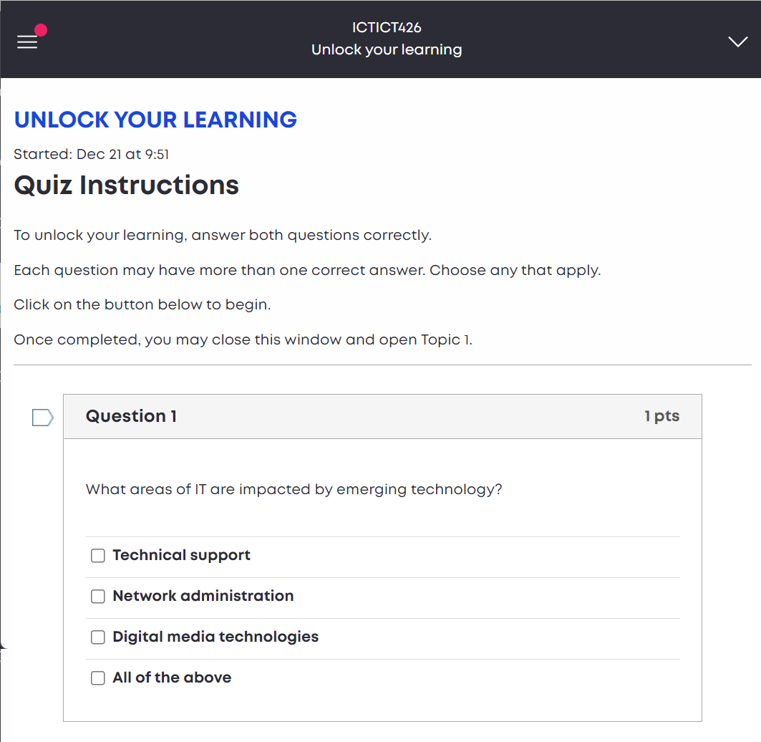
Answer Question 1

Slide 22
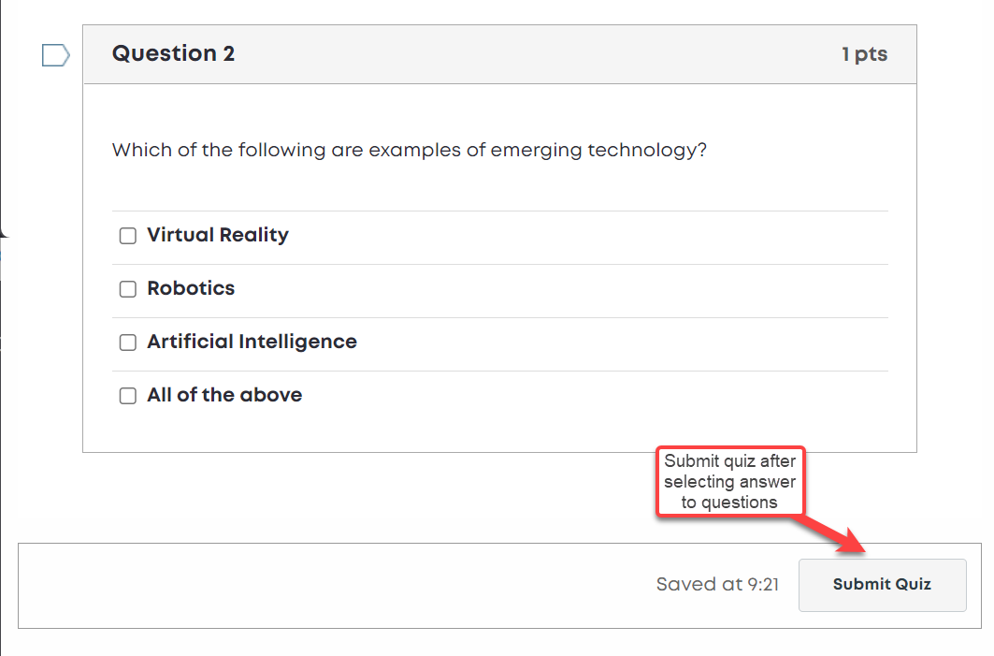
Answer Question 2

Slide 23
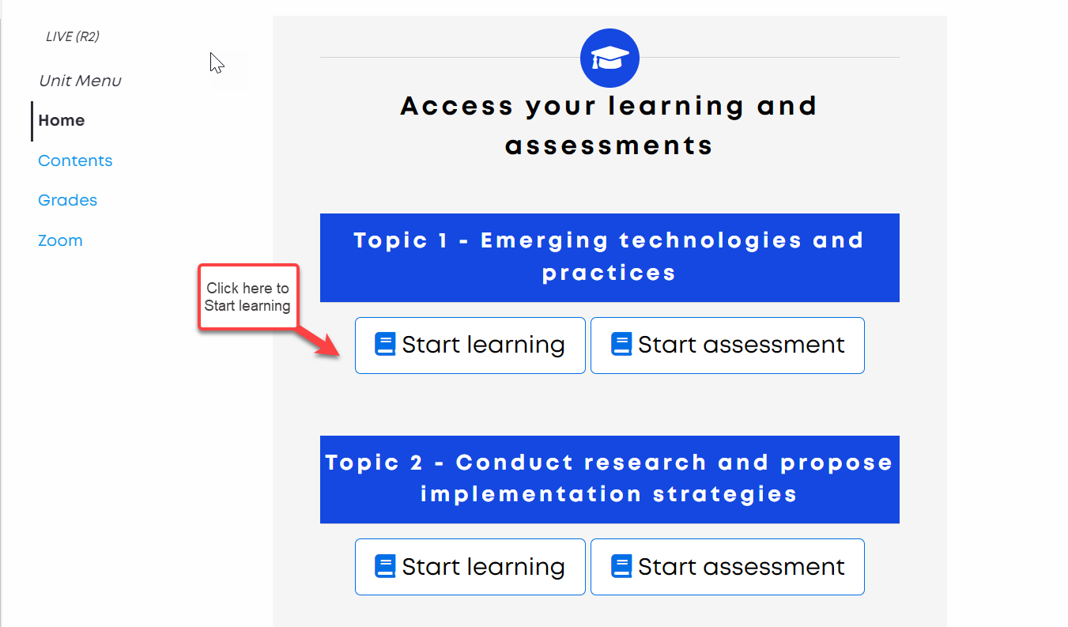
Answer Question 2

Slide 24


We’re excited you’ve joined!
Notes:
We want you to succeed and we will be there at the finish line with you.
We wish you all the best in your student journey with us at Upskilled.

Slide 25


Please ask any questions

